Slide 1
Language is Psychology Too
Dr. Erin Buchanan
Missouri State University

Slide 2

Things to Think About
What daily tasks do you use language for?
  What was the last thing you heard?
  You wrote down?
  How did you know how to do that?

Slide 3
Purpose
What is the purpose of language?
  Communication
  Express emotion
  Social interaction
  Sounds
  Control environment
  Record facts
  Think
  Humor

Slide 4
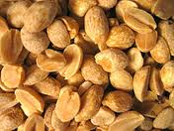
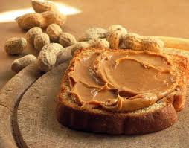
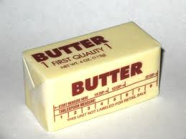
Studying Language
Associations – how we use words in context
+

Slide 5
Studying language
Word frequency – comparing language use from the past to language use now
  Think about your English teacher…how often do they tell you “you can’t write like you talk!”
  How does written text and conversational text overlap?

Slide 6
Studying Language
Associations = Family Feud study
Word Frequency = Facebook study

Slide 7


bake
skillet
beverage
tub
meal
spare
refrigerator
commercial
Score
Exit Game

Slide 8

FAMILY FEUD
Cake 40
1) X X X X X X
Cook 25
2) X X X X X X
Broil 5
3) X X X X X X
Fry 2
4) X X X X X X
X
X
X
Score
bake
Select
Category

Slide 9
FAMILY FEUD
DINOSAUR 43
1) X X X X X X
Drink 49
FOSSIL 21
2) X X X X X X
Soda 29
SHELLS 12
3) X X X X X X
Beer 7
JARASSIC 13
4) X X X X X X
Water 2
X
X
X
Score
Select
Category
beverage

Slide 10
FAMILY FEUD
DINOSAUR 43
1) X X X X X X
Food 49
EONS 5
5) X X X X X X
Ticket 2
FOSSIL 21
2) X X X X X X
Dinner 21
SHELLS 12
3) X X X X X X
Lunch 6
JARASSIC 13
4) X X X X X X
Supper 6
X
X
X
Score
meal
Select
Category

Slide 11
FAMILY FEUD
DINOSAUR 43
1) X X X X X X
Food 42
FOSSIL 21
2) X X X X X X
Cold 27
SHELLS 12
3) X X X X X X
Freezer 12
JARASSIC 13
4) X X X X X X
Cool 5
X
X
X
Score
Select
Category
refrigerator

Slide 12
FAMILY FEUD
DINOSAUR 43
1) X X X X X X
Pan 48
FOSSIL 21
2) X X X X X X
Fry 24
SHELLS 12
3) X X X X X X
Egg 10
JARASSIC 13
4) X X X X X X
Cook 5
X
X
X
Score
skillet
Select
Category

Slide 13
FAMILY FEUD
DINOSAUR 43
1) X X X X X X
Bath 49
EONS 5
5) X X X X X X
Bathroom 3
FOSSIL 21
2) X X X X X X
Water 22
SHELLS 12
3) X X X X X X
Shower 4
JARASSIC 13
4) X X X X X X
Sink 4
X
X
X
Score
tub
Select
Category

Slide 14
FAMILY FEUD
DINOSAUR 43
1) X X X X X X
Tire 42
EONS 5
5) X X X X X X
Time 3
FOSSIL 21
2) X X X X X X
Extra 27
PERIOD 3
6) X X X X X X
Save 3
SHELLS 12
3) X X X X X X
Rib 3
JARASSIC 13
4) X X X X X X
Change 3
X
X
X
Score
spare
Select
Category

Slide 15
FAMILY FEUD
DINOSAUR 43
1) X X X X X X
Television 41
FOSSIL 21
2) X X X X X X
Advertisement 20
SHELLS 12
3) X X X X X X
Business 3
JARASSIC 13
4) X X X X X X
Food 3
X
X
X
Score
Select
Category
commercial

Slide 16
Results

Slide 17
Updating your Status
How Facebook Talk Informs Us About Current Word Use

Slide 18
the Facebook
600 million users
Started at Harvard
  2004 as a company
  2005 bought facebook.com domain

Slide 19
the Facebook
3rd largest web company
  After google.com and amazon.com
In March 2010, had more hits than google.com

Slide 20
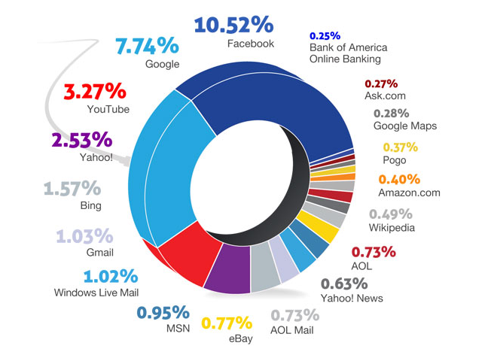

Slide 21

the Facebook
Word Use
  Facebooking, Facebook – 2008
  Unfriend – 2009
The Social Network - 2010

Slide 22
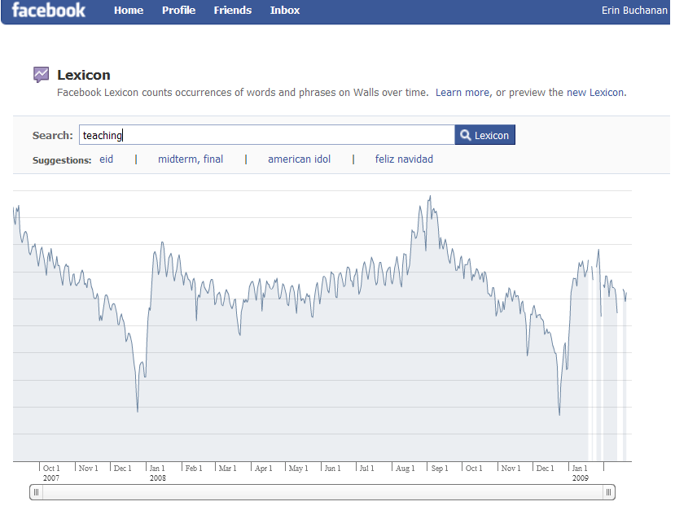

Slide 23
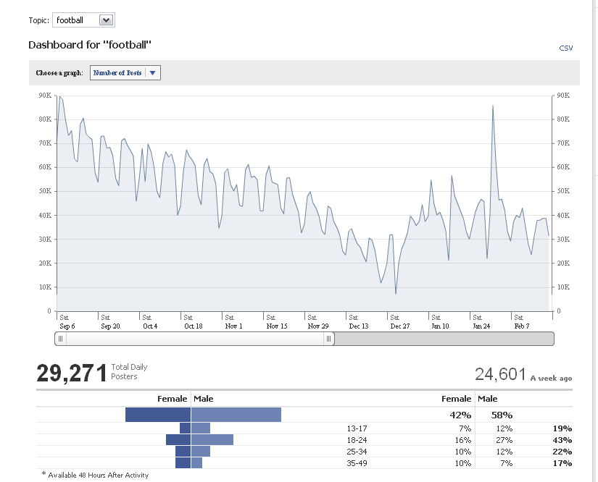

Slide 24
Previous Research
Frequency
  Simple word counts – how often words appear in written text.
  HAL – Hyperspace Analogue to Language (Burgess & Lund, 1997)
  Brown Corpus (Kucera & Francis, 1967)
  Google ngrams (Google.com, 2011)
  Many more….

Slide 25
Current Study
Status Updates
  2004 to present
  Over 2 Gigs of text information
  700+ Facebook walls

Slide 26
Current Study
Each Facebook wall is reduced to posts and statuses
  Then each timestamp is tagged with the status.
    just loves being at work 3 hours after the store closes. Timestamp: Monday, March 29, 2010 at 1:31am
    VEGAS BABY!!!!! Timestamp: Monday, February 1, 2010 at 12:47am
    Flu shot: shot. Hannah Montana band-aid: stuck. Bam. Ready to roll. :) Timestamp: Wednesday, October 27, 2010 at 3:09pm
    Pshhhhh. Timestamp: Saturday, July 11, 2009 at 12:01pm

Slide 27
Current Study
Word Use
  Nearly 40,000 unique words were collected
  Frequency was counted over all words
    Time values to be added later for comparison
  Only words with information in at least one frequency database are used here.
    For example, lol omg are all excluded because they were not in the databases for text word frequency.

Slide 28
Most Common Words
What do you think the most common words are?

Slide 29
Most Common Words
 | Brown Corpus | HAL | Facebook
1 | a | the | I
2 | in | to | you
3 | he | of | to
4 | be | and | the
5 | I | a | a
6 | have | in | and
7 | one | is | is
8 | there | that | it
9 | who | you | in
10 | will | for | my

Slide 30
Results - Overlap
Facebook
HAL
49%
Facebook
Brown
40%

Slide 31
Results – Overlap
There appears to only be a 40-50% overlap between our social word use (hey!) and written word use (Hello.)
  What is the rest?
Most common word uses are still similar
  Pronouns
  Verbs
  Determinants
  Prepositions

Slide 32
Results – Common Uses
There are several social implications from the top 100 words:
  Happy Birthday = 11 and 15
  Love = 26
  Miss = 34
  Hey = 39
  Class = 51
  Haha = 53

Slide 33
Results – So what?
What does this mean for everyday language?
  Language is always changing and evolving – words are deleted and added to the dictionary yearly.
  Over time languages tend to condense – we use less words to emphasize the same meaning.

Slide 34
Questions!

